Slide 1

Reflection of the workshop
Guo-qing Zheng
Okayama University

Slide 2
Many thanks to all of you for your contribution to and participating in this workshop

Slide 3
◎
79
Country
Participants
Oral Speakers
Total Participants
China
49
15
Japan
13
10
41
France
4
3
Oral Presentations
Slovenia
4
4
Croatia
2
2
Germany
2
Europe
15
2
17
Canada
1
1
Posters
Greece
1
1
Italy
1
1
Republic of Korea
1
1
11
Switzerland
1
1
Countries of Participants
Total
79
41
MagRes-2026 Conference Summary
Magnetic Resonance of Correlated Electron Materials
Huairou, Beijing | Sept. 7–12, 2026

Slide 4
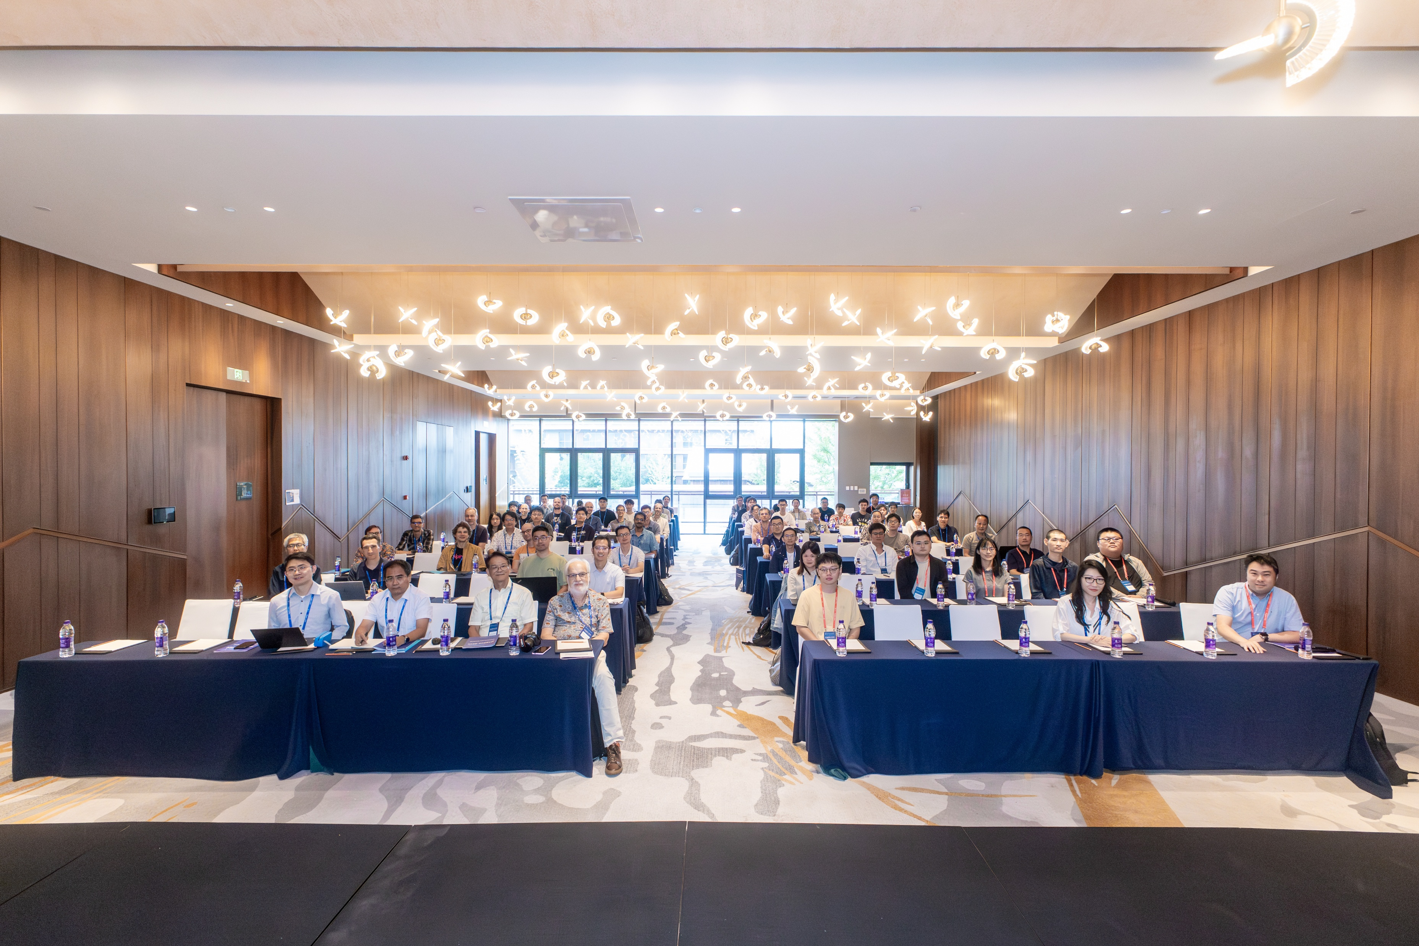

Slide 5
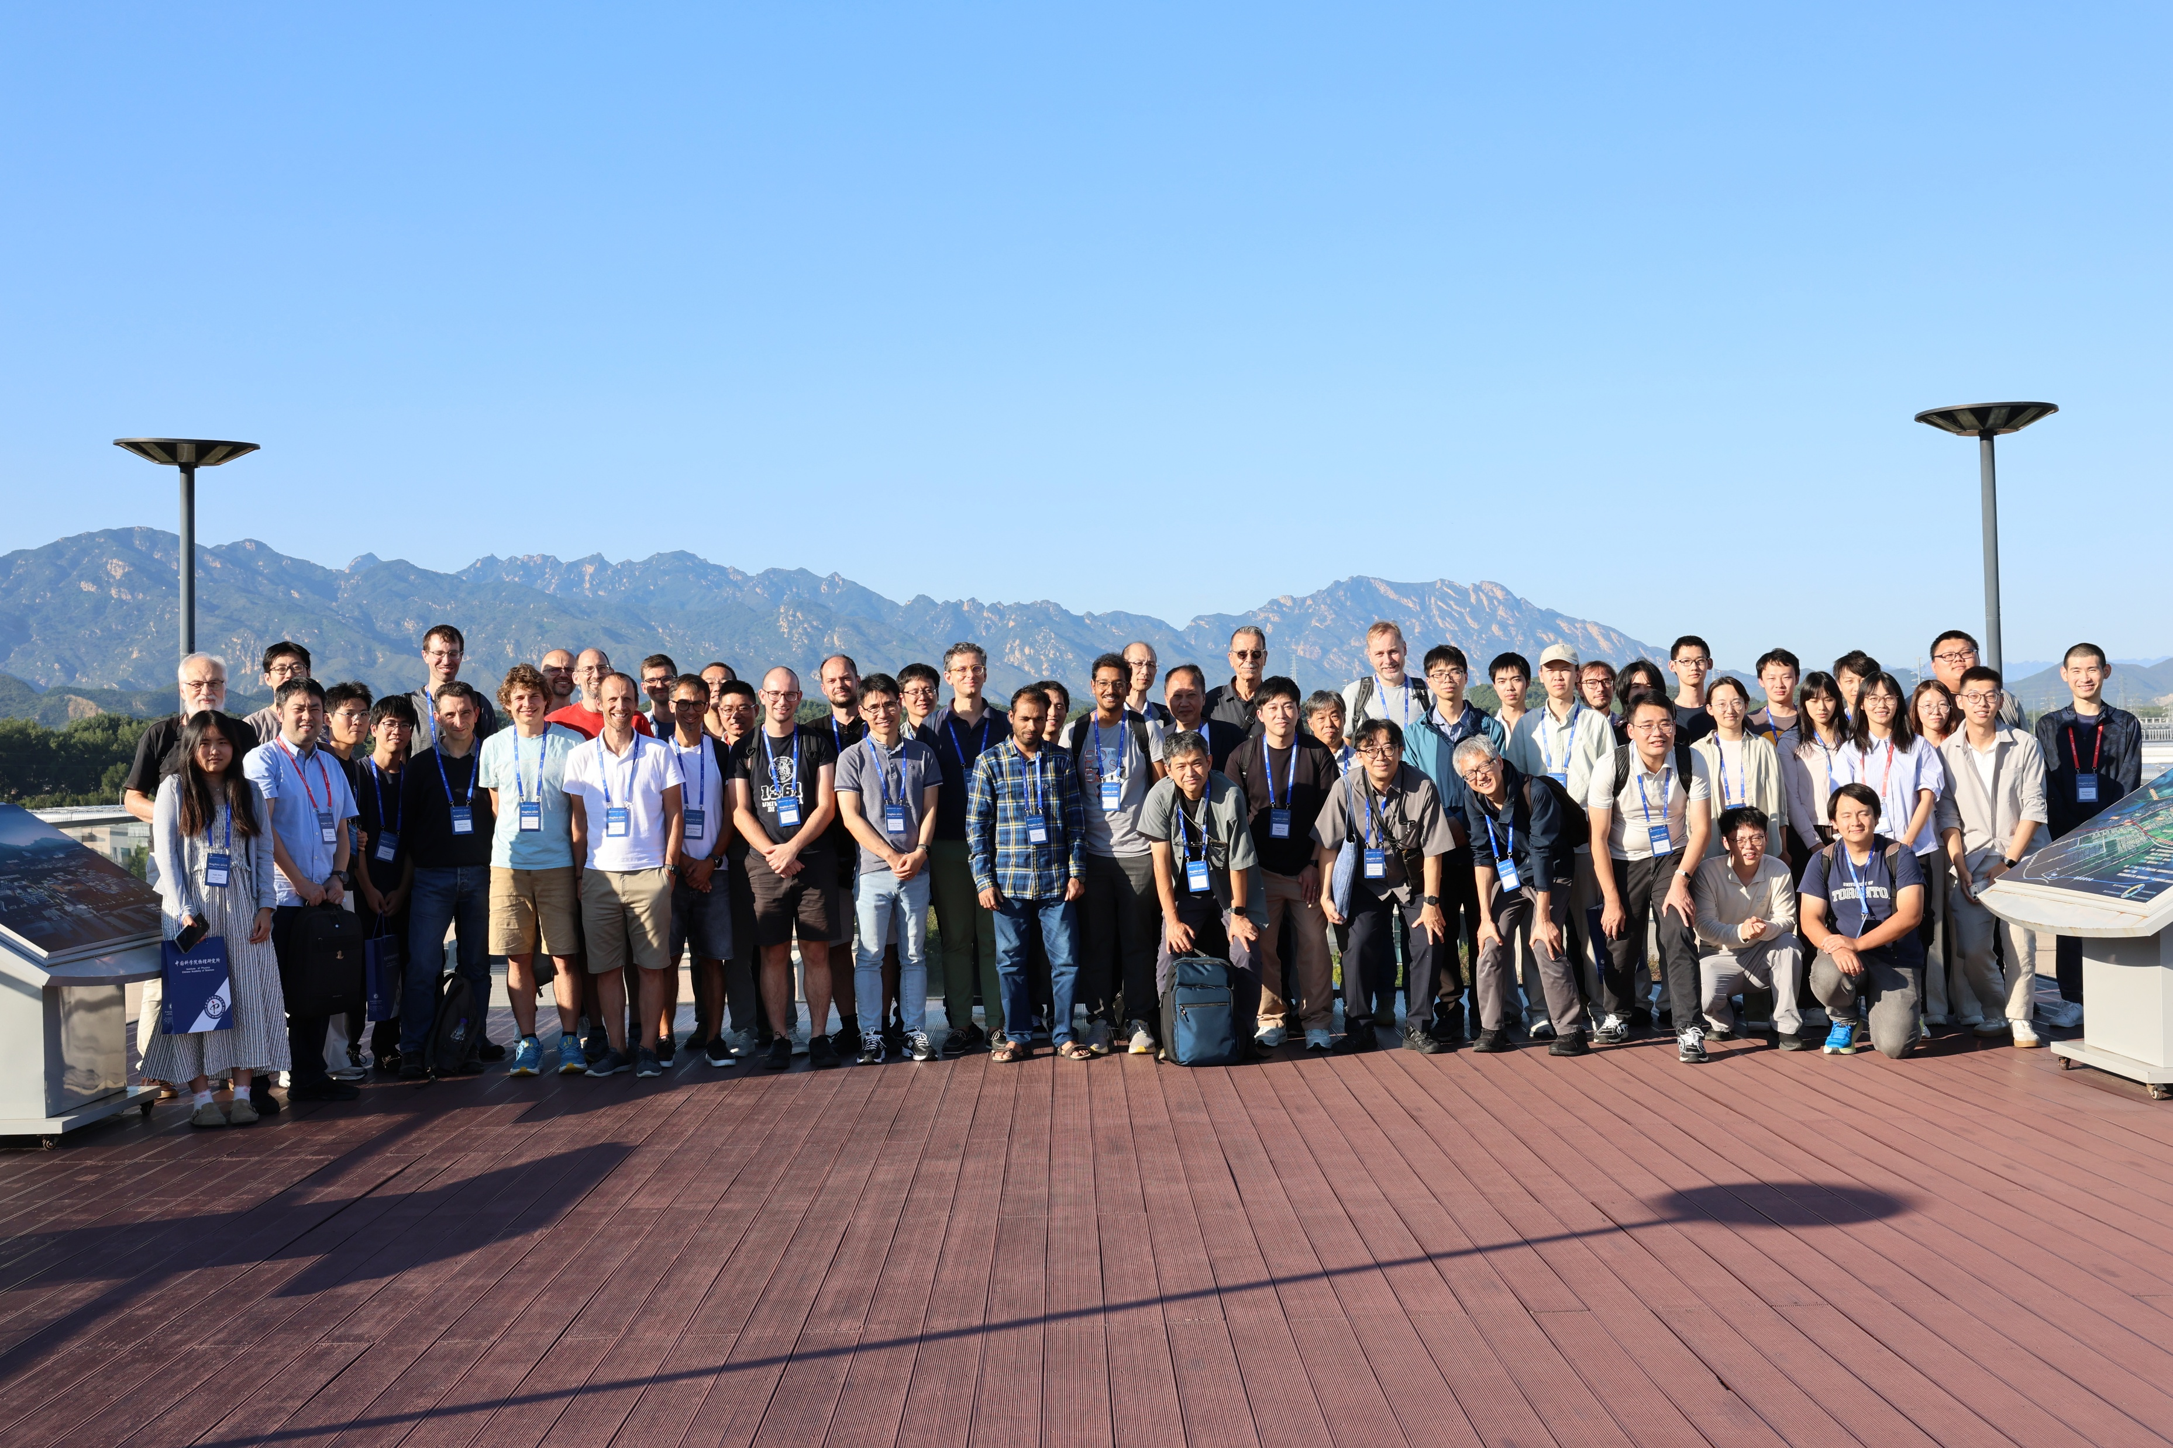

Slide 6
We missed participants from US due to unfortunate restrictions by NSF/DOE

Slide 7
Various Topics Covered/Discussed
NMR continues to play important roles in studies on Quantum magnetism, Superconductivity
Other topics (topological materials, altermagnets, multiple orders, …)
Combined with extreme conditions
New techniques and new instrumentations
(cf Double resonance, Dynamical nuclear polarization…)

Slide 8
NMR/muSR for quantum magnetism (1)
Phenomena: Magnetization Plateau
1/8 M. Horvatic, 1/3 Y. Ihara, 1/9 F. Bert
looking for exotic states on the plateau,
(localized pinwheel, SL, VBCrystal …),
Possible Fractional Excitation (spinon, gapped or gapless)
W. Yu, M. Pregelj, A. Zorko, K. Povarov
Materials: Kagome lattice (Kapelllasite, Herbersmithite, Barlowite…)
M. Grbic, Y. Ihara, F. Bert. A. Zorko
Triangle lattice
L. Shu

Slide 9
NMR/muSR for quantum magnetism (2)
Phenomena: Fractional excitations and Kitaev quantum
spin liquid
G. Papavassiliou, M. Klanjsek
Materials: Honeycomb lattice
G. Papavassiliou, M. Klanjsek
It is impressive to see that NMR can probe both Majorana Fermion excitations and Vison flux

Slide 10
NMR/muSR for quantum magnetism (3)
Low dimensional magnetism and spin chains: localized Zhang-Rice triplet
H.J. Grafe， S.-H. Baek
Heavy Fermions: Ce-, Yb-based, QCP
Y.-K. Luo, H. Sakai
Flat band
L. Zheng
Altermagnets
Y.K. Luo, S. Nandi

Slide 11
NMR for superconductivity (1)
Cuprates: Competition between SC and other orders
G. Simutis， D.Pelc
Nicklates: SDW/CDW order above the SC transition,
mono-. Bi-,tri-layers
H. Mukuda, T. Wu, J. Luo, Y. Wang

Slide 12
NMR for superconductivity (2)
U-, Ce-based: various degree of freedom
K. Ishida, S. Kitagawa, S. Li
Transition-metal compounds: spin-triplet pairing, multiple-component order parameter, multiple phases
S. Ogawa
Kagome-lattice superconductors: multiple gaps, loop current
S. Kawasaki, X.Y. Feng

Slide 13
NMR for topological materials
Vison flux in Kitaev compound
M. Klanjsek
Topological semi-metals
W. Papawassiliou, T. Fujii
Skyrmion
M. Gomilsek

Slide 14
NMR for other topics
Rear-Earth Hexaborides, metal-organic ferromagnets, 1T-TaS2: AF quadrupole order
T. Mito, G. Prando, L. Nie
NMR theory: Y. Zhou, J. Wang
Posters

Slide 15
Extreme conditions
High hydrostatic pressure
K. Kitagawa, W. Yu, G.Q. Liu, Y. Ihara, F. Bert, R. Jana
Uni-axial Strain
G. Simutis, S. Kawasaki,
Low Temperature
M. Horvatic, K. Ishida, S. Kitagawa, X.Y. Feng, S. Li

Slide 16
New methods, New instrumentations
Optical detected NMR
K. Kitagawa, G.Q.Liu
AI assisted NMR
K. Kitagawa
Direct Digital Synthesizer (L. Ma)，Bayesian Interface (T. Mito)

Slide 17
Challenging Expts.: small-gamma nuclei, low-f experiments
³³S-NMR (S.-H. Baek, L. Nie)
Ba-NMR (M. Klanjsek)
Low-freq NQR ~0.5MHz (T. Mito)

Slide 18
History of NMR workshops
Dresden 2005 organized by J. Haase
Trogir (Croatia) 2010, 2011
Beijing 2016 organized by G.-q. Zheng
Dresden2023
Beijing 2026
Where next MagRes?

Slide 19
Thanks to the program committee
Nicholas Curro (UC Davis, USA)
Yuji Furukawa (Iowa State University, USA)
Hans-Joachim Grafe (IFW-dresden, Germany)
Takashi Imai (McMaster University, Canada)
Kenji Ishida (Kyoto University, Japan)
Marc-Henri Julien (LNCMI-CNRS, Grenoble, France)
Hannes Kühne （HZDR, Germany）
Avinash V. Mahajan (IIT Bombay, Mumbai, India)
Vesna Mitrovic (Brown University, USA)
Tao Wu (USTC, Hefei, China)
Andrej Zorko (University of Ljubljana, Slovenia)

Slide 20
Thanks to the organizers
Rui Zhou and his team (Jie Yang, Jun Luo, Shuo Li, Xuyang Feng, Xin Zhang + students)
Secretaries
Jia Wei, Yufei Han, Yixiao Ding
See you on the next occasion!

